Slide 1
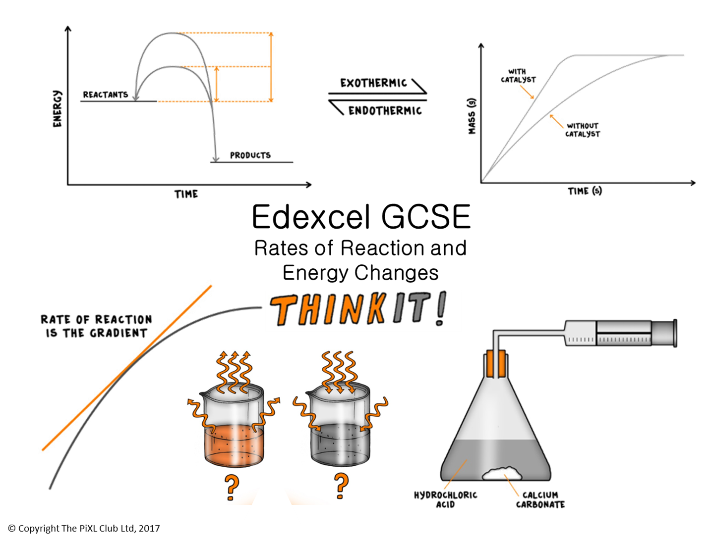

Slide 2
Energy Change (HT):
Describe what bond energy is.
Ethylene and bromine react together to produce ethylene bromide, C₂H₄Br₂. Use your knowledge of bond energy to suggest why this is an exothermic reaction.
Explain how much energy is needed to break all the bonds in 0.960g of oxygen gas.
Catalysts:
Use the lock and key mechanism, with diagrams, to explain why catalysts are reaction specific.
Draw a reaction profile to explain how using a catalyst can increase the rate of reaction.
(HT only) draw a reaction profile to explain why a catalyst would increase the rate of reaction for an endothermic reaction.
Reaction Profiles:
Explain what activation energy is.
Describe, using a reaction profile to help, the bonds being broken and the new bonds being made in the reaction between methane and oxygen which burns to produce carbon dioxide and water.
Factors which affect the rates of reaction
What are the five factors that affect the rate of a reaction and explain how the rate changes when the factor is changed.
Draw a graph to show the change in reaction rate when any one factor is altered.
Explain how you would use a tangent on the graph to calculate the rate of reaction.
Calculating rates of reaction:
A student carried out an experiment to measure the mass of gas lost by a reaction in a certain length of time. The rate of reaction was 1.5 g/sec and the length of time she did the reaction for was 30 seconds. How much gas was lost and what was the unit?
(HT only) 11g of carbon dioxide was released by a reaction in 40 seconds, Calculate the rate of reaction in moles per second.
Edexcel GCSE Rates of Reaction and Energy Changes
ThinkIT!
© Copyright The PiXL Club Ltd, 2017
Exothermic Reactions:
"Energy cannot be created or destroyed“. Explain how chemical reactions obey this law.
Explain why it is difficult to measure the energy released from an exothermic reaction in the classroom. Suggest control measures you could use to do this as accurately as possible.
Describe how the reaction between nitric acid and sodium hydroxide is exothermic.
Collision theory and activation energy
Explain, using the collision theory, how increasing concentration and decreasing the size of solid reacting particles can increase the rate of reaction.
Describe what activation energy is and explain why reactions with high activation energies are difficult to start.
Endothermic Reactions:
Explain why a temperature decrease in surroundings is an endothermic reaction.
Explain how the reaction between ammonium nitrate and water is an endothermic reaction.

